Slide 1
ECEG-5193: Algorithm Analysis and Design
Algorithm Design Techniques
Algorithm classification

Slide 2
Algorithm classification
This classification scheme is neither exhaustive nor disjoint
The purpose is
not to be able to classify an algorithm as one type or another, but
to highlight the various ways in which a problem can be attacked

Slide 3
A short list of categories
Brute force algorithms
Divide and conquer algorithms
Dynamic programming algorithms
Greedy algorithms
Backtracking algorithms
Branch and bound algorithms
Randomized algorithms

Slide 4
Brute force algorithm
A brute force algorithm simply tries all possibilities until a satisfactory solution is found
Such an algorithm can be:
Optimizing: Find the best solution. This may require finding all solutions, or if a value for the best solution is known, it may stop when any best solution is found
Example: Finding the best path for a traveling salesman
Satisficing: Stop as soon as a solution is found that is good enough
Example: Finding a traveling salesman path that is within 10% of optimal

Slide 5
Improving brute force algorithms
Often, brute force algorithms require exponential time.
Various heuristics and optimizations can be used
Heuristic:
A “rule of thumb” that helps you decide which possibilities to look at first
Optimization:
In this case, a way to eliminate certain possibilities without fully exploring them

Slide 6
Backtracking algorithms
Tests to see if a solution has been found, and if so, returns it; otherwise
For each choice that can be made at this point,
Make that choice
Recur
If the recursion returns a solution, return it
If no choices remain, return failure
If the current state is not feasible

Slide 7
Divide and Conquer
Consists of two parts:
Divide the problem into smaller subproblems of the same type, and solve these subproblems recursively
Combine the solutions to the subproblems into a solution to the original problem
Traditionally, an algorithm is only called “divide and conquer” if it contains at least two recursive calls
Notes:
2

Slide 8
Dynamic programming algorithms
A dynamic programming algorithm remembers past results (“memoization”) and uses them to find new results
Dynamic programming is generally used for optimization problems
Multiple solutions exist, need to find the “best” one
Requires “optimal substructure” and “overlapping subproblems”
Optimal substructure: Optimal solution contains optimal solutions to subproblems
Overlapping subproblems: Solutions to subproblems can be stored and reused in a bottom-up fashion
This differs from Divide and Conquer, where subproblems generally need not overlap

Slide 9
Greedy algorithms
An optimization problem is one in which you want to find, not just a solution, but the best solution
A “greedy algorithm” sometimes works well for optimization problems
A greedy algorithm works in phases: At each phase:
You take the best you can get right now, without regard for future consequences
You hope that by choosing a local optimum at each step, you will end up at a global optimum
Notes:
2

Slide 10
Branch and bound algorithms
Branch and bound algorithms are generally used for optimization problems
As the algorithm progresses, a tree of subproblems is formed
The original problem is considered the “root problem”
A method is used to construct an upper and lower bound for a given problem
At each node, apply the bounding methods
If the bounds match, it is deemed a feasible solution to that particular subproblem
Continue, using the best known feasible solution to trim sections of the tree, until all nodes have been solved or trimmed

Slide 11
Example branch and bound algorithm
Traveling salesman problem: A salesman has to visit each of n cities (at least) once each, and wants to minimize total distance traveled
Consider the root problem to be the problem of finding the shortest route through a set of cities visiting each city once
Split the node into two child problems:
Shortest route visiting city A first
Shortest route not visiting city A first
Continue subdividing similarly as the tree grows

Slide 12
Randomized algorithms
A randomized algorithm uses a random number at least once during the computation to make a decision
Example: In Quicksort, using a random number to choose a pivot
Example: Trying to factor a large number by choosing random numbers as possible divisors

Slide 13

Example
The
Knapsack Problem

Slide 14

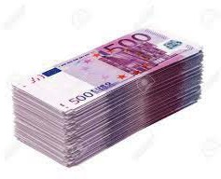
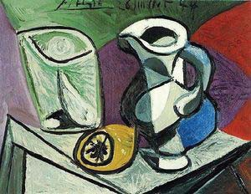
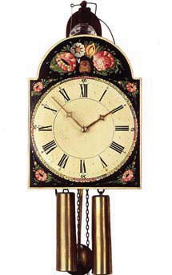
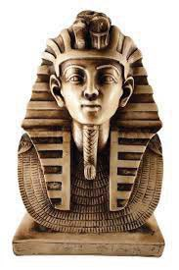
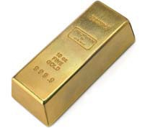
What would you pick?

Slide 15
Knapsack Problems

Slide 16
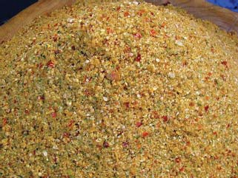
Knapsack Problem
You have limited strength, so there is a maximum weight knapsack that you can carry
You would like to take more stuff than you can carry
How do you choose which stuff to take and which to leave behind?
Two variants
0/1 knapsack problem
Continuous or fractional knapsack problem

Slide 17
Another Example
You are about to sit down to a meal
You know how much you value different foods, e.g., you like donuts more than apples
But you have a calorie budget, e.g., you don't want to consume more than 750 calories
Choosing what to eat is a knapsack problem

Slide 18
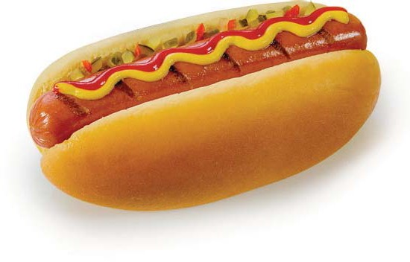
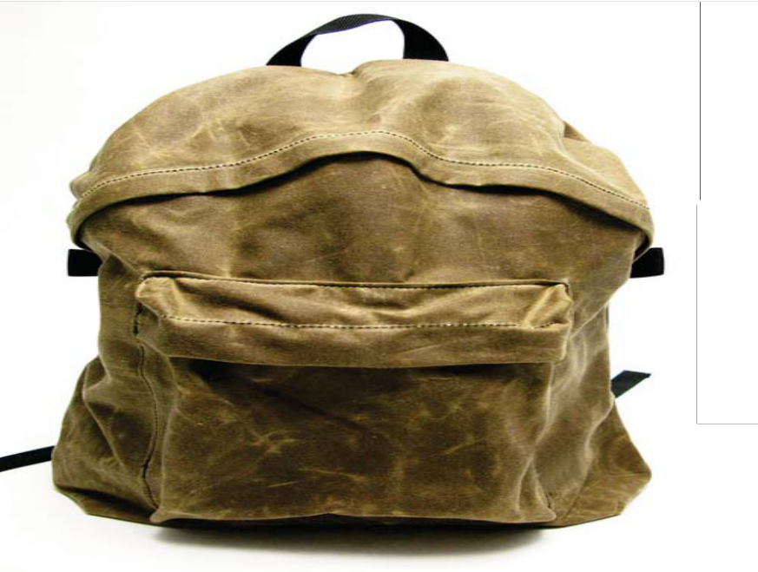
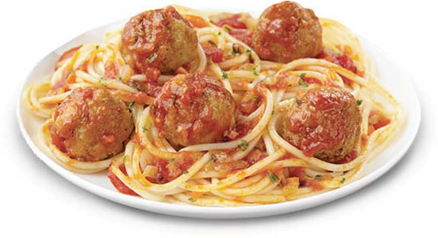
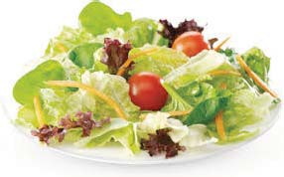
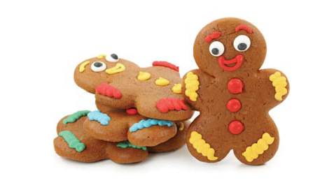




Another Knapsack Problem

Slide 19
Brute Force Algorithm
Enumerate all possible combinations of items. That is to say, generate all subsets of the set of items. This is called the power set.
Remove all of the combinations whose total units exceeds the allowed weight.
From the remaining combinations choose any one whose value is the largest.

Slide 20
Brute Force Knapsack
def knapsack (items, maxweight):
best = {}
bestvalue = 0
for s in allPossibleSubsets (items):
value = 0
weight = 0
for item in s:
value += item.value
weight += item.weight
if weight <= maxweight:
if value > bestvalue:
best = s
bestvalue = value
return best
(Defining and
analyzing this might be a good Exam 1 question)

Slide 21
Brute Force Knapsack Analysis
How many subsets are there?
How much work for each subset?
2^{n}
for item in s:
value += item.value
weight += item.weight
Average size of each subset is n/2
(there are as many subsets with size c and of size n – c)
Running time ∈ Θ(n2^{n})

Slide 22
Is it Practical?
How big is power set?
How many possible different values can V have?
As many different binary numbers as can be represented in n bits
For example, if there are 100 items to choose from, the power set is of size?
1,267,650,600,228,229,401,496,703,205,376
0/1 knapsack problem is inherently exponential

Slide 23
Greedy Algorithm a Practical Alternative
while knapsack not full
put “best” available item in knapsack
But what does best mean?
Most valuable
Least expensive
Highest value/units

Slide 24
Greedy Knapsack Algorithm
Repeat until no more items fit:
Add the most valuable item that fits
“Greedy”: always picks the most valuable item that fits first

Slide 25
Greedy Knapsack Algorithm
def knapsack_greedy (items, maxweight):
result = []
weight = 0
while True:
# try to add the best item
weightleft = maxweight - weight
bestitem = None
for item in items:
if item.weight <= weightleft \
and (bestitem == None \
or item.value > bestitem.value):
bestitem = item
if bestitem == None: break
else:
result.append (bestitem)
weight += bestitem.weight
return result
Running Time
∈Θ(n²)

Slide 26
The Pros and Cons of Greedy
Easy to implement
Computationally efficient
But does not always yield the best solution
Don't even know how good the approximation is

Slide 27
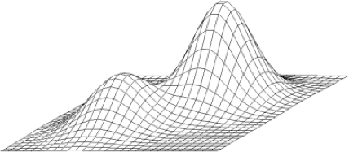
Why Different Answers?
Sequence of locally "optimal" choices don't always yield a globally optimal solution

Slide 28
What about Dynamic programming

Slide 29
Dynamic programming
A dynamic programming algorithm
remembers past results (“memoization”) and uses them to find new results
Requires
Optimal substructure: Optimal solution contains optimal solutions to subproblems
Overlapping subproblems: Solutions to subproblems can be stored and reused in a bottom-up fashion

Slide 30
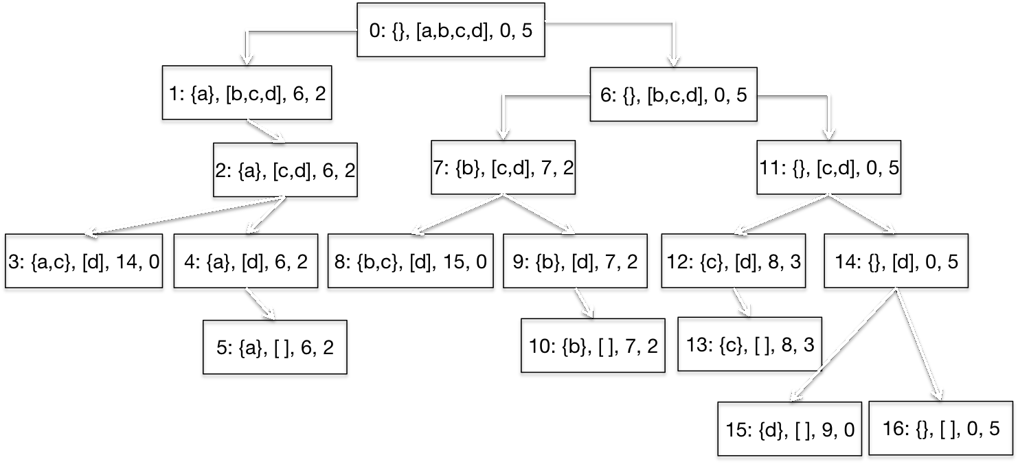
Overlapping Subproblems
Each node = <taken, left, value, remaining calories>

Slide 31
Divide and Conquer

Slide 32
A Legend
Legend has it that there were three diamond needles set into the floor of the temple of Brahma in Hanoi.
Stacked upon the leftmost needle were 64 golden disks, each a different size, stacked in concentric order:

Slide 33
A Legend (Ct’d)
The priests were to transfer the disks from the first needle to the second needle, using the third as necessary.
But they could only move one disk at a time, and could never put a larger disk on top of a smaller one.
When they completed this task, the world would end!

Slide 34
Tower of Hanoi
Assume one disk can be moved in 1 second
How long would it take to move 64 disks? N disks?
To create an algorithm to solve this problem, it is convenient to generalize the problem to the “N-disk” problem, where in our case N = 64.

Slide 35
Recursive Solution

Slide 36
Recursive Solution

Slide 37
Recursive Solution

Slide 38
Recursive Solution

Slide 39
Tower of Hanoi

Slide 40
Tower of Hanoi

Slide 41
Tower of Hanoi

Slide 42
Tower of Hanoi

Slide 43
Tower of Hanoi

Slide 44
Tower of Hanoi

Slide 45
Tower of Hanoi

Slide 46
Tower of Hanoi

Slide 47
The Towers of Hanoi
Pseudocode solution
solveTowers(n, source, destination, spare)
{
if (count is 1)
Move a disk directly from source to destination
else
{
solveTowers(n-1, source, spare, destination)
solveTowers(1, source, destination, spare)
solveTowers(n-1, spare, destination, source)
}

Slide 48
The Cost of Towers of Hanoi
moves(N ) = 2^{N} – 1, for all N ≥ 1
O(2^{n})

Slide 49
Coding
void Move(int n, char src, char dest, char aux)
{
if (n > 1)
{
Move(n-1, src, aux, dest);
Move(1, src, dest, aux);
Move(n-1, aux, dest, src);
}
else
cout << “Move the top disk from “
<< src << “ to “ << dest << endl;
}

Slide 50
Testing
The Hanoi Towers
Enter how many disks: 1
Move the top disk from A to B

Slide 51
Testing (Ct’d)
The Hanoi Towers
Enter how many disks: 2
Move the top disk from A to C
Move the top disk from A to B
Move the top disk from C to B

Slide 52
Testing (Ct’d)
The Hanoi Towers
Enter how many disks: 3
Move the top disk from A to B
Move the top disk from A to C
Move the top disk from B to C
Move the top disk from A to B
Move the top disk from C to A
Move the top disk from C to B
Move the top disk from A to B

Slide 53
Testing (Ct’d)
The Hanoi Towers
Enter how many disks: 4
move a disk from needle A to needle B
move a disk from needle C to needle B
move a disk from needle A to needle C
move a disk from needle B to needle A
move a disk from needle B to needle C
move a disk from needle A to needle C
move a disk from needle A to needle B
move a disk from needle C to needle B
move a disk from needle C to needle A
move a disk from needle B to needle A
move a disk from needle C to needle B
move a disk from needle A to needle C
move a disk from needle A to needle B
move a disk from needle C to needle B

Slide 54
Analysis
Let’s see how many moves” it takes to solve this problem, as a function of n, the number of disks to be moved.
n Number of disk-moves required
1 1
2 3
3 7
4 15
5 31
...
i 2^{i}-1
64 2⁶⁴-1 (a big number)

Slide 55
Analysis (Ct’d)
How big?
Suppose that our computer and “super-printer” can generate and print 1,048,576 (2²⁰) instructions/second.
How long will it take to print the priest’s instructions?
There are 2⁶⁴ instructions to print.
Then it will take 2⁶⁴/2²⁰ = 2⁴⁴ seconds to print them.
1 minute == 60 seconds.
Let’s take 64 = 2⁶ as an approximation of 60.
Then it will take ≅ 2⁴⁴ / 2⁶ = 2³⁸ minutes to print them.

Slide 56
Analysis (Ct’d)
Hmm. 2³⁸ minutes is hard to grasp. Let’s keep going...
1 hour == 60 minutes.
Let’s take 64 = 2⁶ as an approximation of 60.
Then it will take ≅ 2³⁸ / 2⁶ = 2³² hours to print them.
1 day == 24 hours.
Let’s take 32 = 2⁵ as an approximation of 24.
Then it will take ≅ 2³² / 2⁵ = 2²⁷ days to print them.

Slide 57
Analysis (Ct’d)
Hmm. 2²⁷ days is hard to grasp. Let’s keep going...
1 year == 365 days.
Let’s take 512 = 2⁹ as an approximation of 365.
Then it will take ≅ 2²⁷ / 2⁹ = 2¹⁸ years to print them.
1 century == 100 years.
Let’s take 128 = 2⁷ as an approximation of 100.
Then it will take ≅ 2¹⁸ / 2⁷ = 2¹¹ centuries to print them.

Slide 58
Analysis (Ct’d)
Hmm. 2¹¹ centuries is hard to grasp. Let’s keep going...
1 millennium == 10 centuries.
Let’s take 16 = 2⁴ as an approximation of 10.
Then it will take ≅ 2¹¹ / 2⁴ = 2⁷ = 128 millennia
just to print the priest’s instructions (assuming our computer doesn’t crash, in which case we have to start all over again).
How fast can the priests actually move the disks?
...

Slide 59
Summary
Recursion is a valuable tool that allows some problems to be solved in an elegant and efficient manner.
Functions can sometimes require more than one recursive call in order to accomplish their task.
There are problems for which we can design a solution, but the nature of the problem makes solving it effectively uncomputable.

Slide 60
Brute Force Subset Sum
def subsetsum (items, maxweight):
best = {}
for s in allPossibleSubsets (items):
if sum (s) <= maxweight \
and sum (s) > sum (best)
best = s
return best
Just like brute force knapsack:
Running time ∈ Θ(n2^{n})

Slide 61
Greedy Subset Sum?
Pick largest item that fits
Bad: I = { 4, 5, 7 } W = 9
Pick smallest item
Bad: I = { 4, 5, 7 } W = 7
Doesn’t prove there is no myopic criteria that works
Note: Subset Sum is known to be NP-Complete, so finding one would prove P = NP

Slide 62
Summary
Many problems of practical importance can be formulated as optimization problems
Greedy algorithms often provide adequate (though not necessarily optimal) solutions
Finding an optimal solution is usually exponentially hard
But dynamic programming often yields good performance for a subclass of optimization problems— those with optimal substructure and overlapping subproblems
Fast under the right circumstances

